Slide 1

Creating, Publishing and Reusing an Oracle JET Composite Component
Lucas Jellema, CTO of AMIS
nlOUG Tech Experience 2018, Amersfoort, The Netherlands
Notes:
Lucas Jellema Developer Champion (NL)
Parallel session 3.5b Intermediate
Creating, Publishing and Reusing a JET Composite Component [25 min]
Composite Components are a crucial element in the evolution of Oracle JET. These components allow organizations to better structure their enterprise applications built with JET and to introduce efficiency and UX consistency through reuse UI components. JET Composite Components are also shared across the boundaries of enterprises, throughout the community, to be consumed in JET applications anywhere and in Visual Builder Cloud applications. This session demonstrates how a JET Composite Component is designed and implemented. The component introduces a Geographical Map on which data bound locations (regions, countries, states and cities) can be indicated and selected. The component supports two way data binding, configuration properties and it publishes events. It leverages open source map and geocoding libraries. This session demonstrates how the component is packaged and published and how it can be reused in a JET application as well as in Visual Builder Cloud. It will allow you to start reusing, building and publishing your own JET Composite Components.

Slide 2

Lucas Jellema Architect / Developer 1994 started in IT at Oracle 2002 joined AMIS Currently CTO & Solution Architect

Slide 3
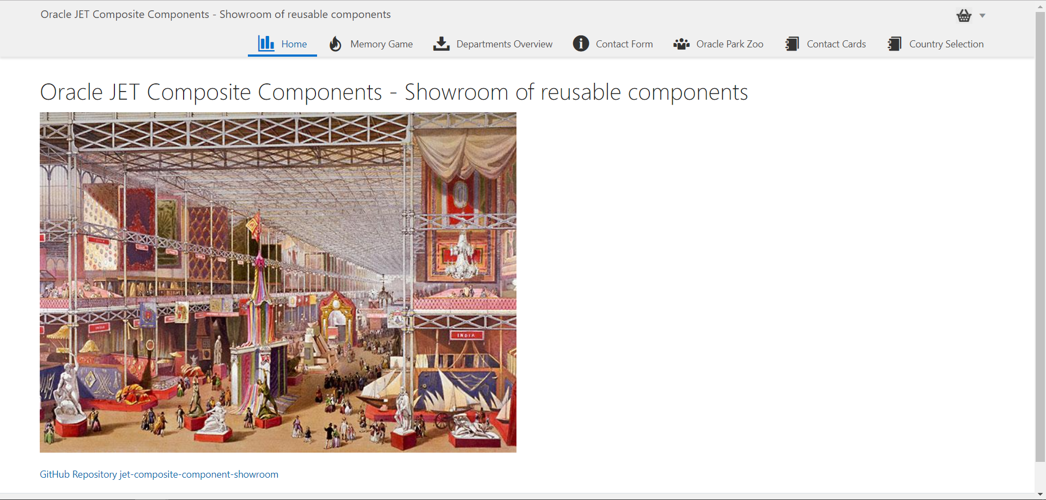

Slide 4
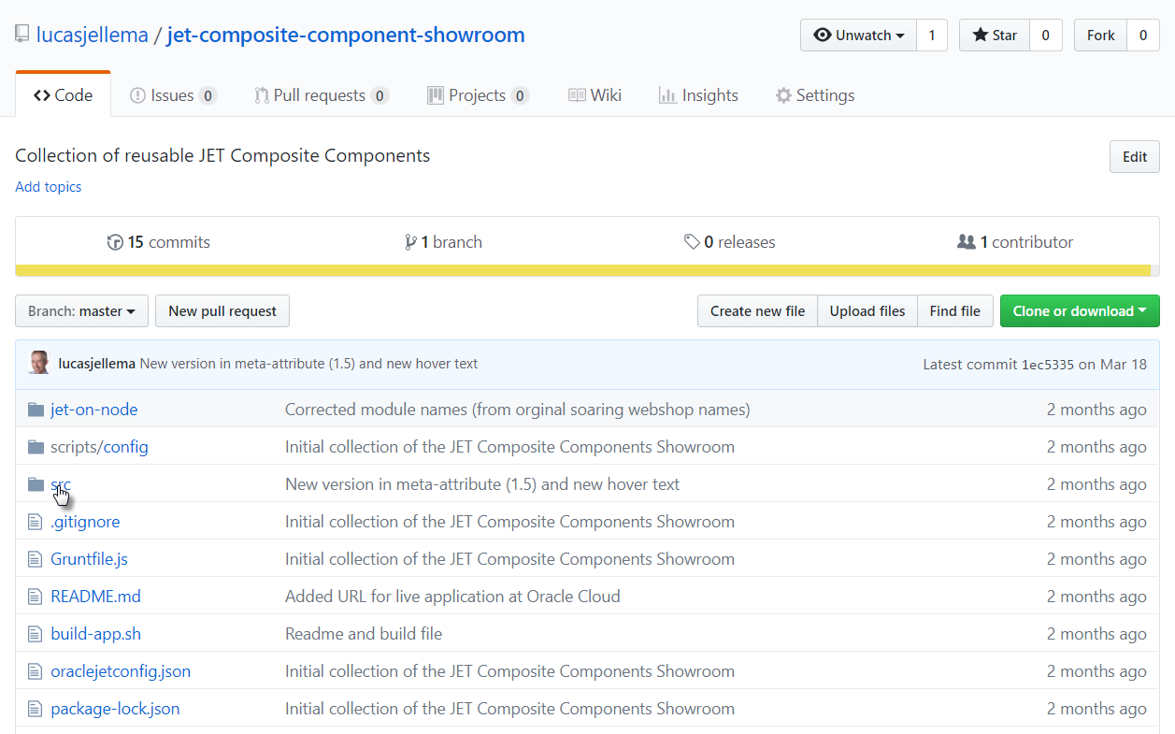
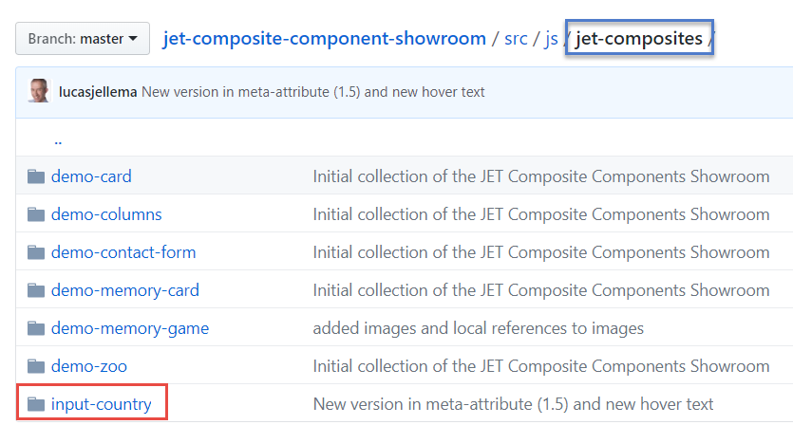

Slide 5

Demo
Create JET Application WikiCountryBrowser
Import JET Composite Component CountryBrowser
Configure Composite Component
Create page and embed CountryBrowser
Run application

Slide 6
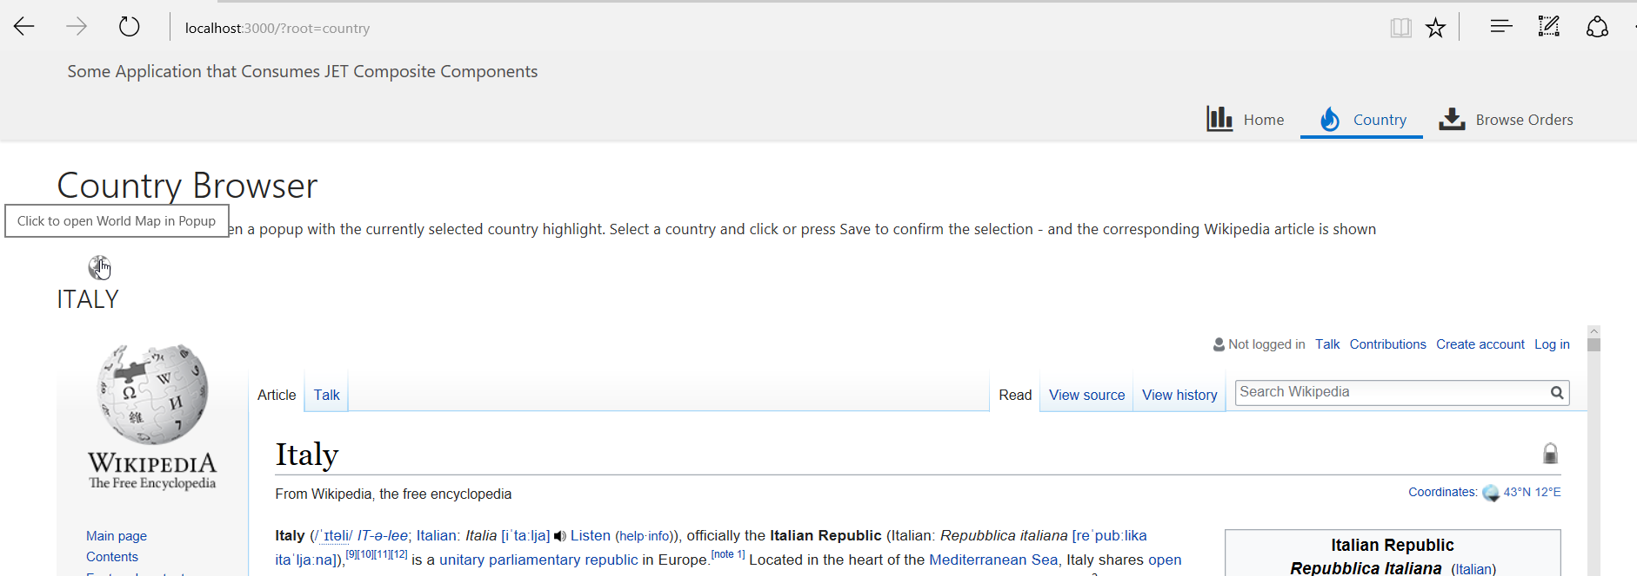
The application is running in a live environment (for example Oracle Application Container Cloud)
Note the hover text shown for the globe image

Slide 7
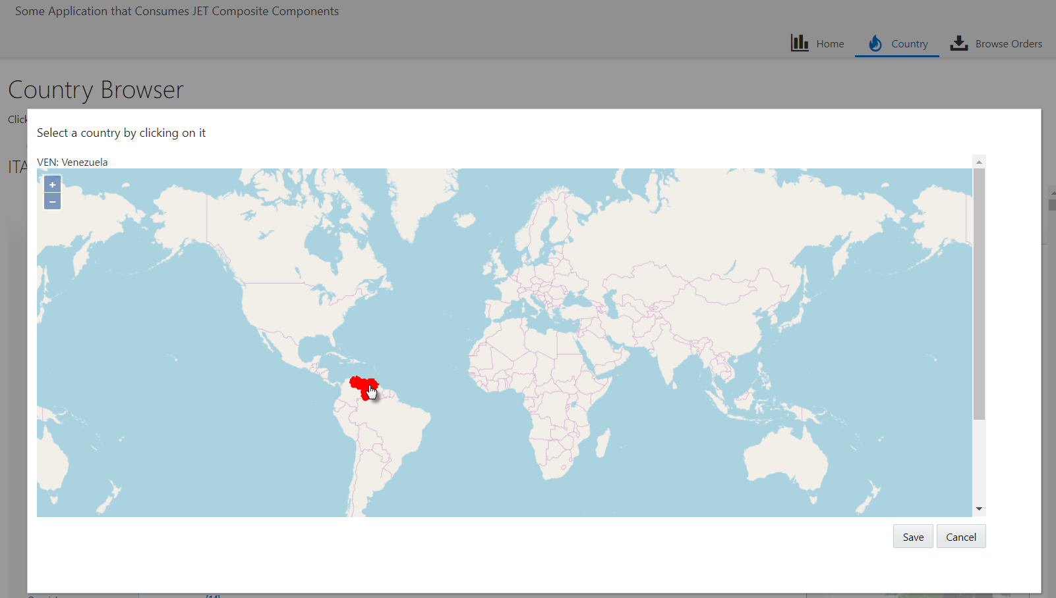
Click on country

Slide 8
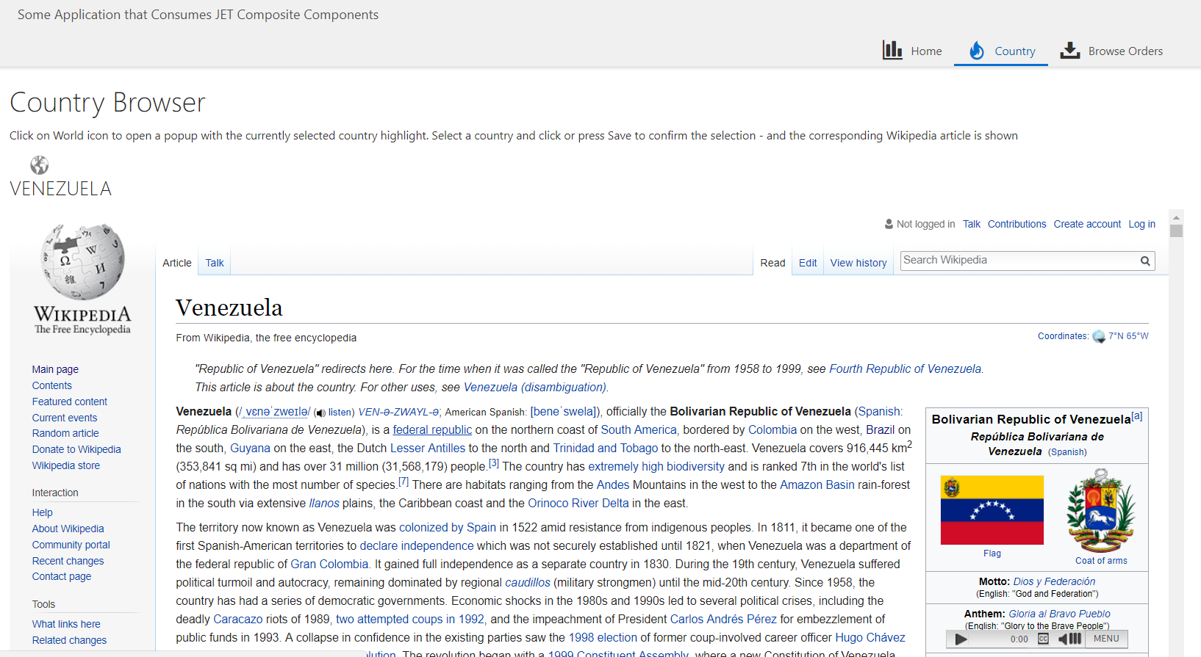
Wikipedia details for newly selected country are shown in an IFRAME

Slide 9
Beauty of Composite Components
Share & Reuse
Internally in application and throughout organization
Externally across the community
Compartimentalize development effort – make smaller, stand alone pieces
Micro….
Bonus: low code extension

Slide 10
Introducing JET Composite Component Architecture (CCA): “A composite component is a reusable piece of UI that can be embedded as a custom HTML element and can be composed of other composites, JET components, HTML, JavaScript, or CSS.”
Notes:
http://www.oracle.com/webfolder/technetwork/jet/jetCookbook.html?component=composite&demo=basic

Slide 11
JET Composite Component
A reusable building block – encapsulated with a well defined interface
Created using HTML, CSS, JavaScript, JET resources, other CCA components
Packaged in a Zip file that can be shared with any application and any team
Easily ‘injected’ into a JET application
copy contents of zip-file to specific directory
And easily used in a page
Add tag to View
Load module in ViewModel
JET CCA
InputSmiley
My JET Application
Your JET Application
Page 1
Page 2
JET CCA
InputSmiley
JET CCA
InputSmiley
Page A
Page B
<input-smiley>
<input-smiley>
<input-smiley>
<input-smiley>
<input-smiley>
<input-smiley>
<input-smiley>

Slide 12
Constitution of a JET Composite Component
JET CCA
Component
UI (HTML + CSS)
Events, Property Updates, Function calls

Slide 13
Constitution of a JET Composite Component
JET CCA
Component
UI (HTML + CSS)
loader.js
view.html
Events, Property Updates, Function calls
component.json
styles.css
Other Resources
viewModel.js

Slide 14
Constitution of a JET Composite Component
Property values (can be Observables and callback functions), Function Calls
JET CCA
Component
UI (HTML + CSS)
loader.js
view.html
Events, Property Updates, Function calls
component.json
styles.css
Other Resources
viewModel.js

Slide 15
Creation of a component
Identify scope of the component
Create a regular JET application (ojet)
Generate a composite component (ojet)
Identify and separate two areas
Test bed, sandbox – used for development & test
Composite Component
Iteratively
Configure & Describe
Develop
Test
Publish

Slide 16
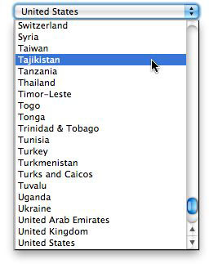
Develop Input Country Component
Scope: display and select country on a map
Zoom, pan, ..
For example instead of:
Later: extend with
multiple countries
Regions, cities

Slide 17
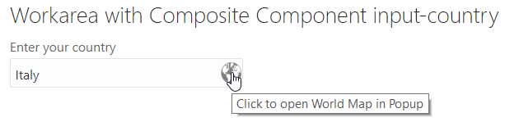
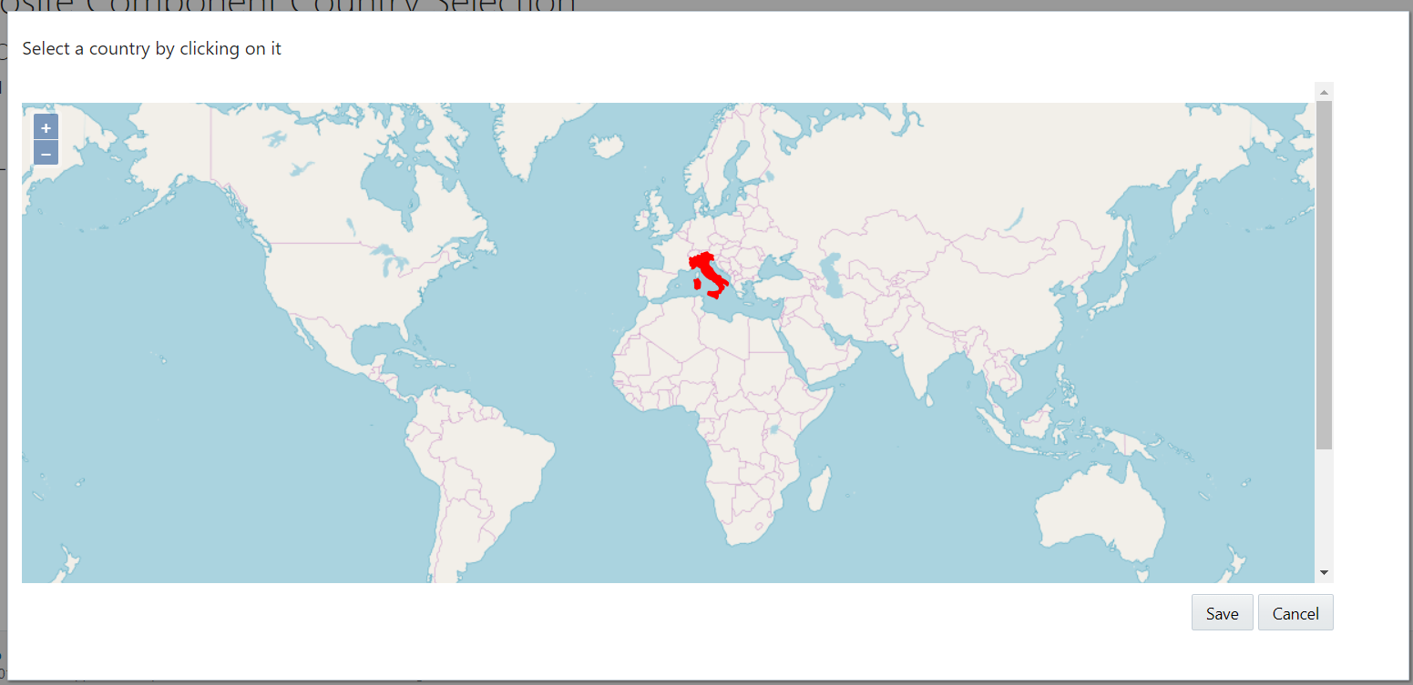

Slide 18
Input Country
Create a regular JET application input-country-sandbox
Generate Composite Component input-country
Identify and separate two areas
Test bed, sandbox – used for development & test
Composite Component
Iteratively
Configure & Describe
Develop
Test
Publish

Slide 19
Special attention
Properties (observable)

Slide 20
Output from a Component
Call injected function
Publish Event
Set injected observable value
(be inspected from the consuming application)
(publish event explicitly on client side event bus)

Slide 21
Consume a JET Composite Component in your own application
Unzip the zip-file to the src/js/jet-composites directory in the target JET project
Add a reference to the component in the define() call in the viewModel for the view that consumes the component: 'jet-composites/input-country/loader'
Add the markup for the component to the view’s HTML document

Slide 22
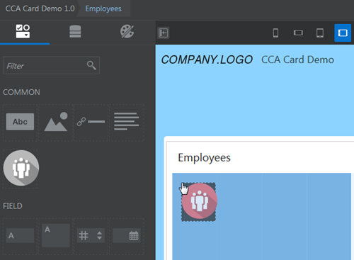
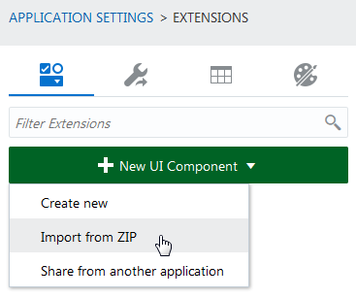
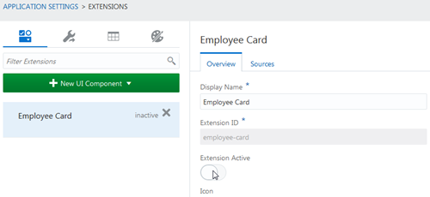
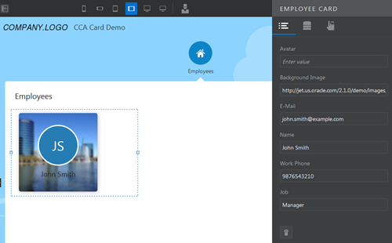
Leverage in Visual Builder Cloud

Slide 23

Summary
Components are good:
Reuse
Productivity
Clean design
Best practices
It’s like micro…
JET Composite Composite Components are straightforward
Create them like small, structured, well documented JET applications
Use them by copying a zip, configuring some properties and embedding in a view
JET Composite Components can be used in Oracle Visual Builder Cloud
I envision (or at least hope for) a world with many shared community composite components

Slide 24
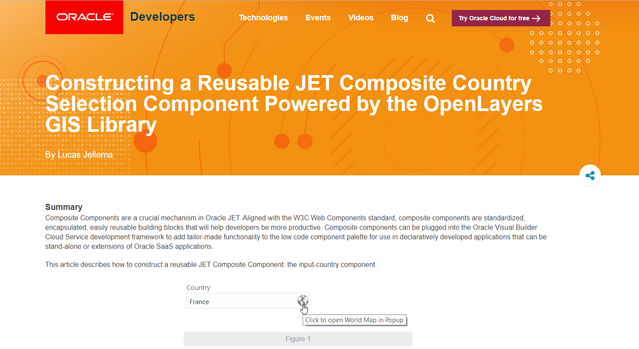
Some resources
Article: https://developer.oracle.com/javascript/reusable-jet-composite
GitHub Resources:
https://github.com/lucasjellema/jet-composite-component-showroom
https://github.com/lucasjellema/input-country-composite-component

Slide 25





Thank you Dank je wel
Blog: technology.amis.nl
Email: lucas.jellema@amis.nl
: @lucasjellema
: lucas-jellema
: www.amis.nl, info@amis.nl
https://github.com/lucasjellema/jet-composite-component-showroom
https://github.com/lucasjellema/input-country-composite-component

